Slide 1
Understanding the seasonality of the Automotive Industry
University of Illinois Chicago - Capstone Team #3
December 8th, 2023

Slide 2
AGENDA
01
02
03
04
05
PROJECT OBJECTIVES
TIMELINE/MILESTONES
PHASES
RESULTS
Q&A

Slide 3
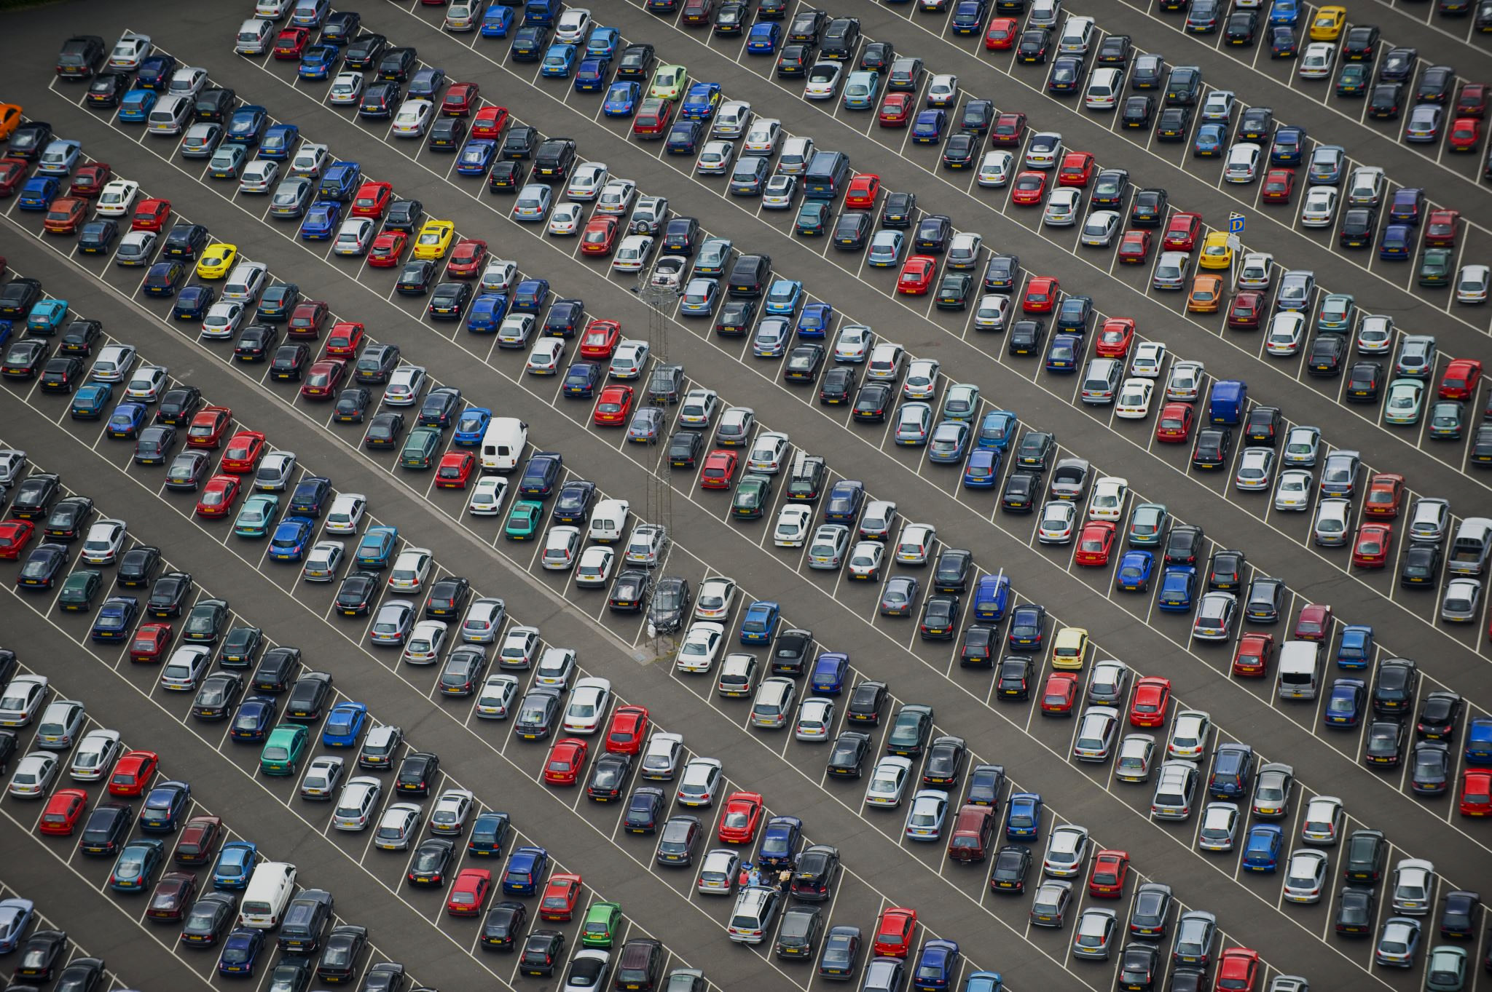
Project Objectives
Key Objectives:
- Understanding the impact of various factors on used car prices
- Developing a predictive model for estimating prices
Major Deliverables:
- Report: Insights into the factors affecting car prices.
- Predictive Model: A robust tool for estimating prices, incorporating current market conditions and historical data.
© CCC Information Services Inc. All rights reserved.

Slide 4

Project Life Cycle
Exploration of Dataset
Model Testing & Selection
Final Report
10/5/2023
10/29/2023
11/30/2023
START
END
Feature Selection, Data Enhancement
Advanced Modeling
11/15/2023
10/12/2023

Slide 5
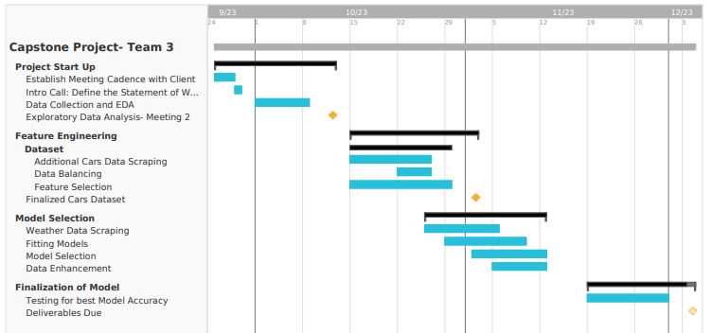
Project Management

Slide 6



Phased Approach
Phase 1: Exploring the Data
Phase 2: Incorporating Weather Data
Phase 3: Enhancing the Datasets
Phase 4: Improving Model Accuracy

Slide 7
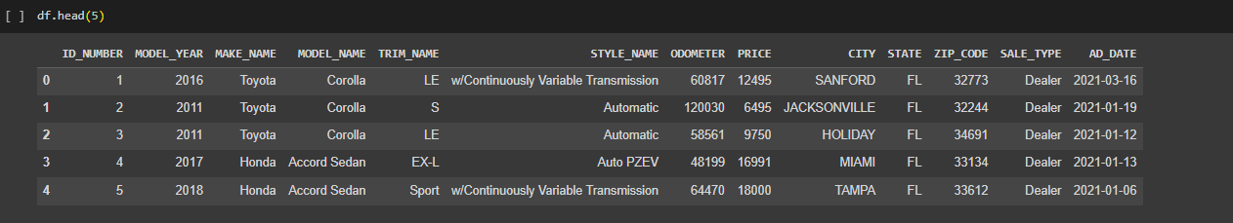
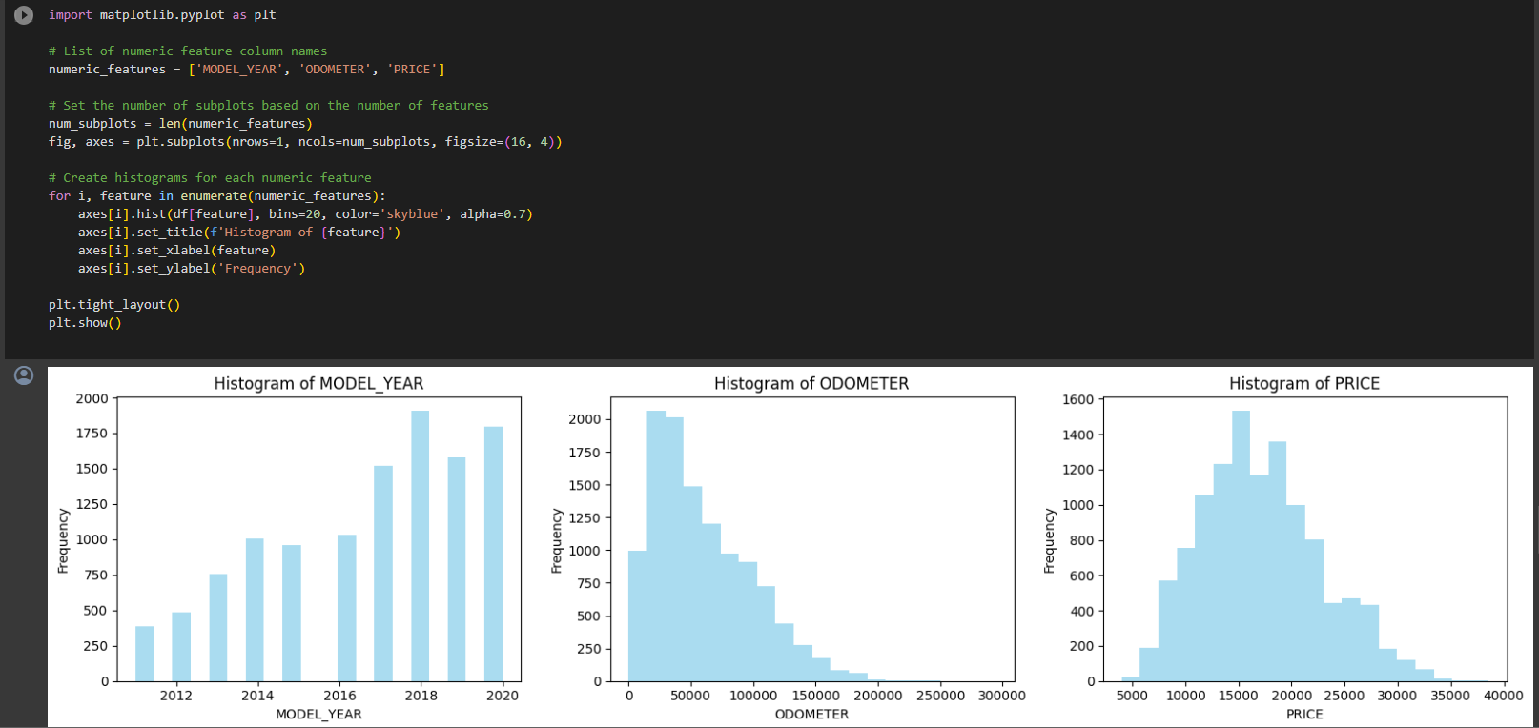
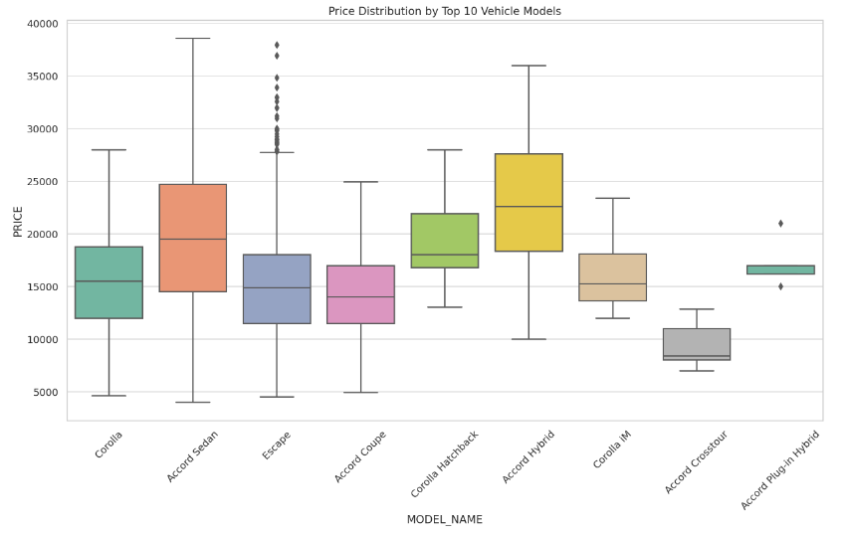
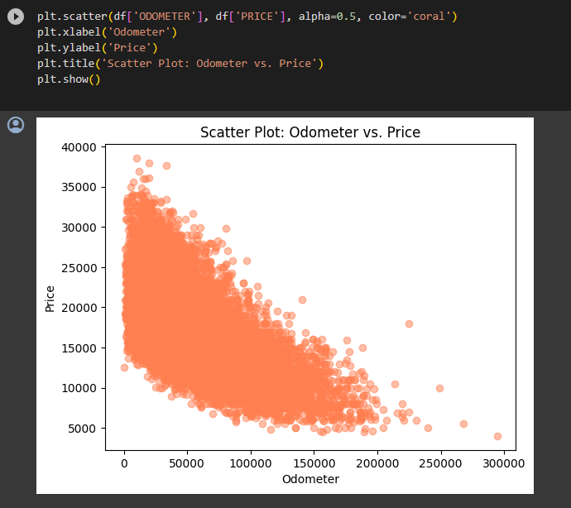
Phase 1: Exploring Cars Data
We obtained cars data from CCCIS. The dataset contains 14,582 rows and 13 columns.

Slide 8
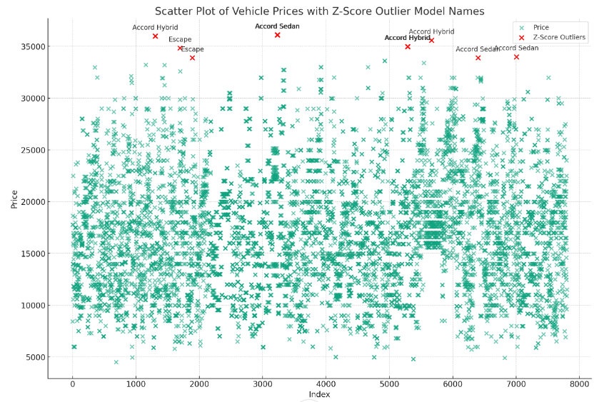
Phase 1: Exploring Cars Data - Outliers

Slide 9
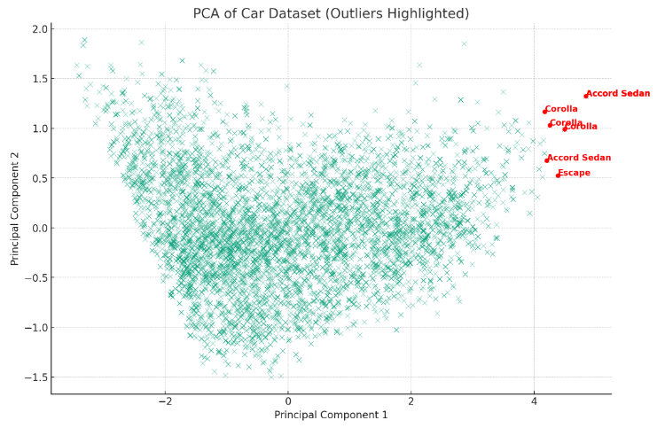
Phase 1: Exploring Cars Data - Outliers

Slide 10
Phase 2: Incorporating Weather Data
Source of Weather Data
● National Center for Environmental Information - NOAA
Weather Features Analyzed
● Primary Features: Precipitation, Fog, Heavy Rain, Thunder, Hail, Smoke, High Winds
● Data Type: All features except Precipitation are Flags (Boolean)
Geocoding and Data Imputation
● Method: Using geocoding to determine latitudes and longitudes for each zip code
● Imputation: Missing data for each weather feature filled based on lat, long, and date
● Note on Temperature: Omitted due to significant missing values, to preserve data integrity
Shifting Weather Data for Analysis
● Data Structure: Weather information aligned with car sales data
● Time Frames Considered: Conditions 7 days, 15 days, and 30 days prior to each car sale
date
Notes:
Weather data was scraped from NATIONAL CENTER FOR ENVIRONMENTAL INFORMATION - NATIONAL OCEANIC AND ATMOSPHERIC ADMINISTRATION
Weather features - Precipitation, Fog, Heavy Rain, Thunder, Hail, Smoke, High Winds All the weather features except precipitation were Flag(Boolean)
Using geocoding, we found out the latitudes and longitudes for each zip code. Then using the lat, long and date we imputed the missing data for each weather feature. Temperature had a lot of missing values and imputing data would diminish the quality of data.
Shifting the weather data, we made dataframes in such a way that for each sale we had 7 days ago, 15 days ago and 30 days ago weather data

Slide 11
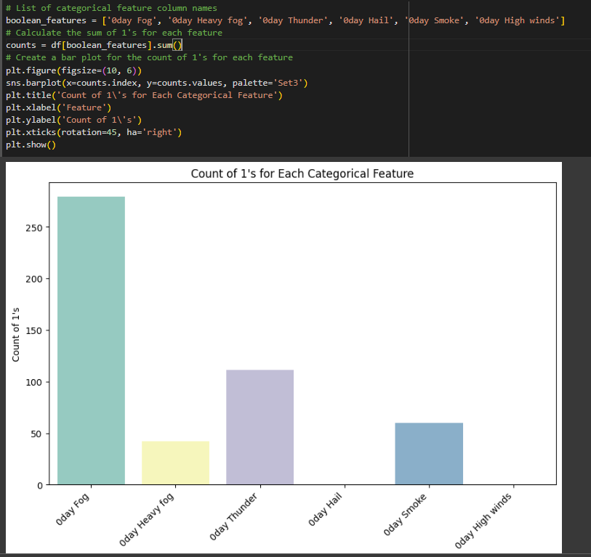
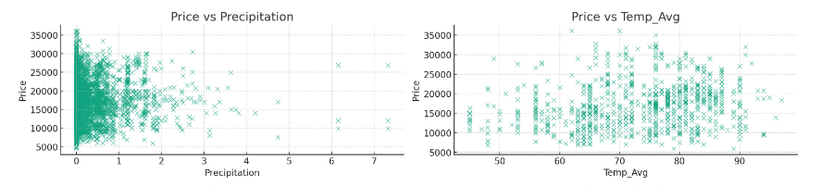
Phase 2: Incorporating Weather Data - Visualizations
Notes:
Weather data was scraped from NATIONAL CENTER FOR ENVIRONMENTAL INFORMATION - NATIONAL OCEANIC AND ATMOSPHERIC ADMINISTRATION
Weather features - Precipitation, Fog, Heavy Rain, Thunder, Hail, Smoke, High Winds All the weather features except precipitation were Flag(Boolean)
Using geocoding, we found out the latitudes and longitudes for each zip code. Then using the lat, long and date we imputed the missing data for each weather feature. Temperature had a lot of missing values and imputing data would diminish the quality of data.
Shifting the weather data, we made dataframes in such a way that for each sale we had 7 days ago, 15 days ago and 30 days ago weather data

Slide 12
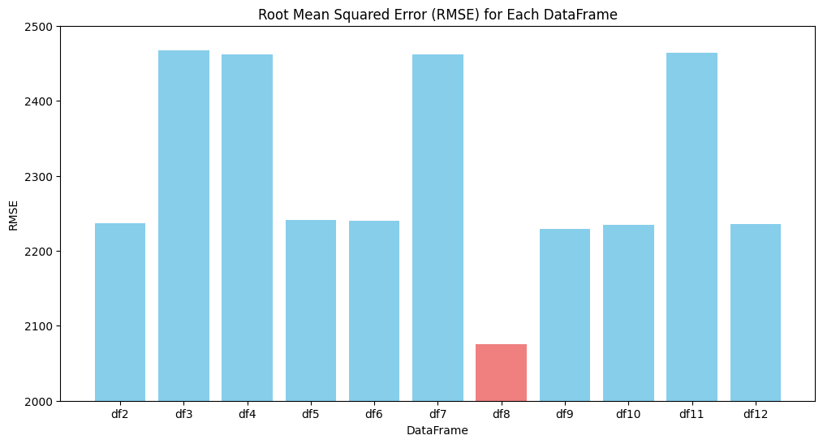
Phase 3: Enhancing the Datasets: Data Combinations
Linear Regression on different combinations of shifted Data
To test out how much different combinations of shifts in Weather Data affect the model performance, we test the RMSE values of different combinations of shifts.
df8 is the combination of 7 day and 15 day shited data used together

Slide 13
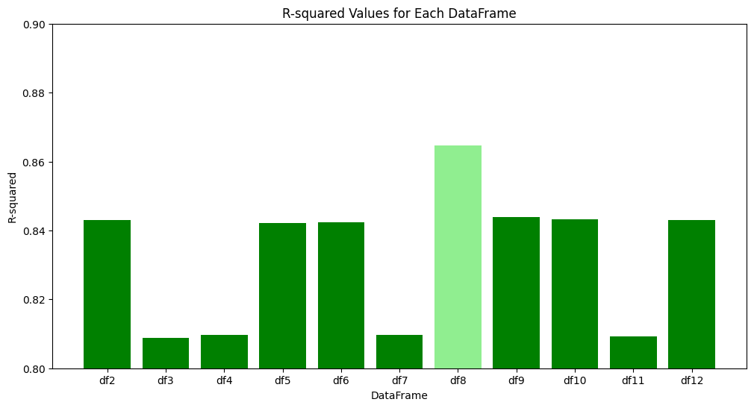
Phase 3: Enhancing the Dataset: Data Combinations
Linear Regression on different combinations of shifted Data
To test out how much different combinations of shifts in Weather Data affect the model performance, we test the RMSE values of different combinations of shifts.
df8 is the combination of 7 day and 15 day shited data used together

Slide 14
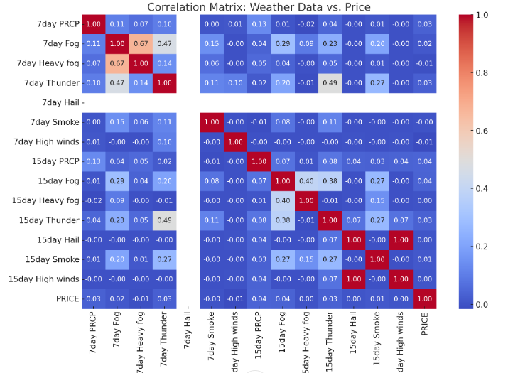
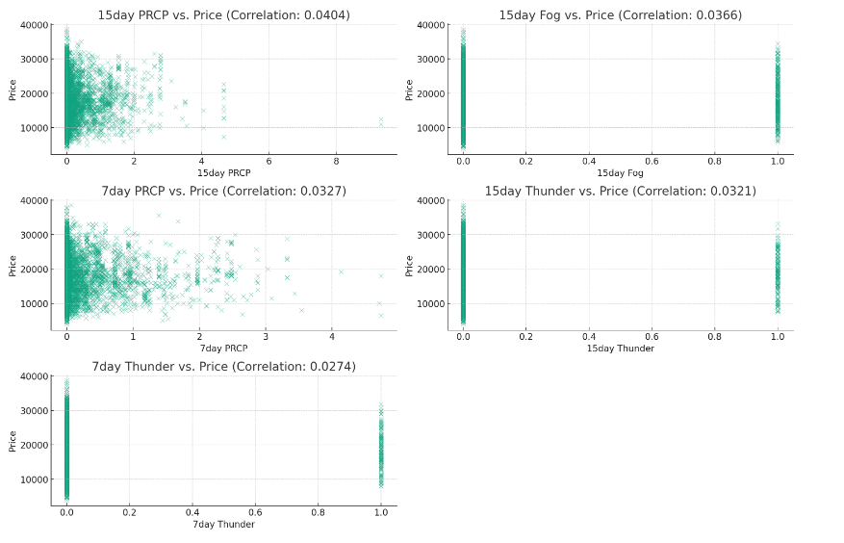
Phase 3: Enhancing the Dataset: Visualizing combinations (1/2)
Combination of 7 Days and 15 days shift

Slide 15
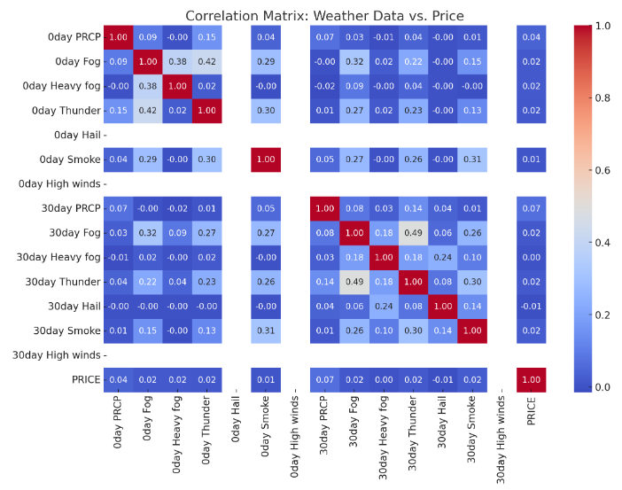
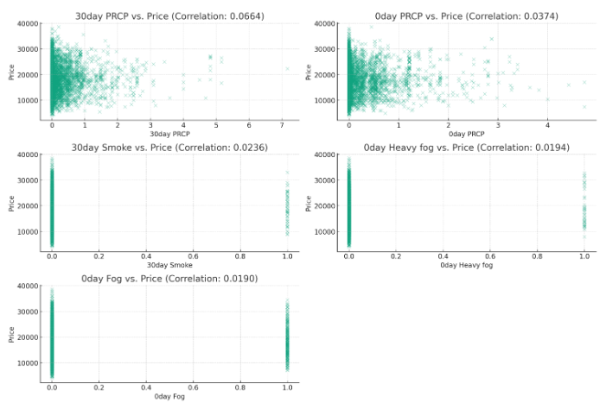
Phase 3: Enhancing the Dataset: Visualizing combinations (2/2)
Combination of 0 Days and 30 days shift

Slide 16
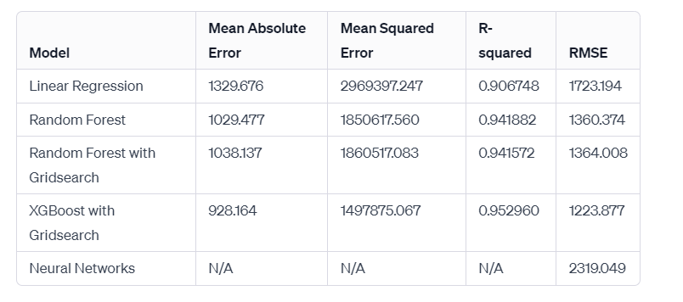
Phase 4: Modelling Results
Combination of 7 Days and 15 days shift
The XGBoost with Gridsearch model seems to perform the best across all provided metrics. ​

Slide 17
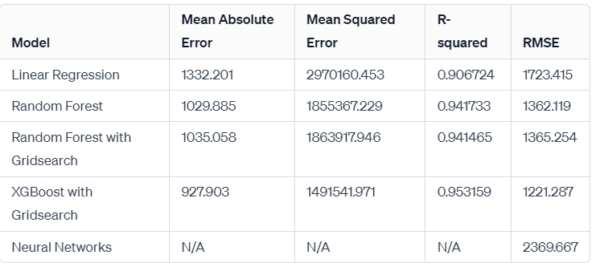
Phase 4: Modelling Results
Combination of 0 Days and 30 days shift
The XGBoost with Gridsearch model seems to perform the best across all provided metrics. ​

Slide 18
Q & A

